Slide 1
AINT351: Machine Learning Lecture 1 Introduction to the course

Slide 2
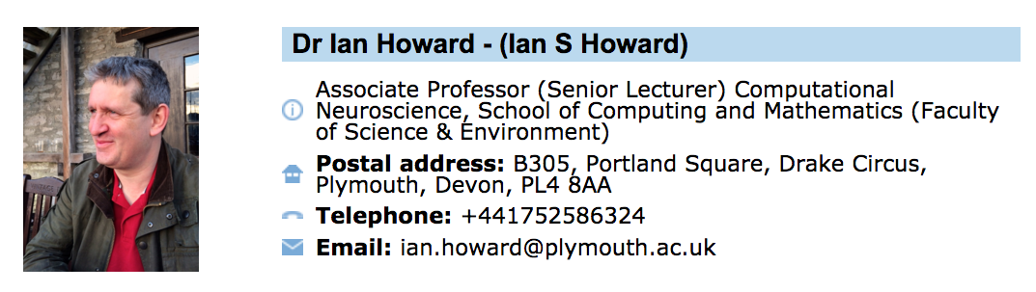
Introduction
Who am I?
A324
Who are you?
What do you all already know about machine learning?

Slide 3
Availability
I have lots of time (2 hours) to deal with your queries in the laboratory sessions
Otherwise, the best thing to do is to email me first and see if I can sort out your query. If not then I will arrange a time to meet up with you.
Don’t forget – if you have any problems, or even if you are not sure about something - just email me
ian.howard@plymouth.ac.uk
I am located in Room A324, Block A, Portland Square.

Slide 4
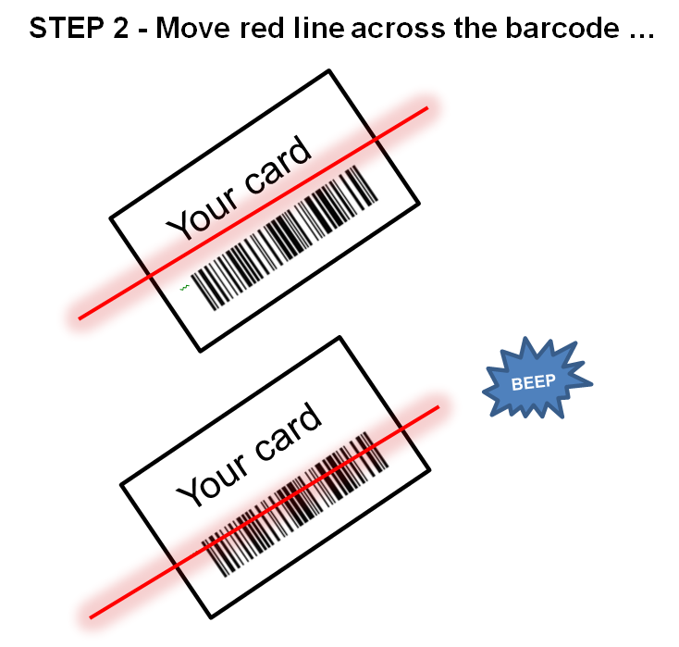
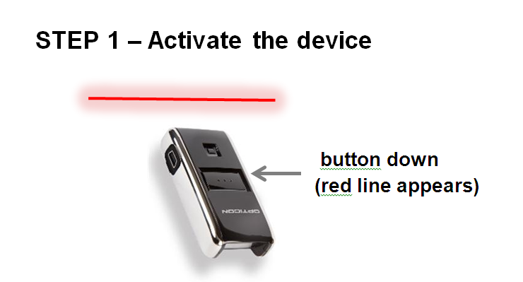
Registration

Slide 5
Special needs
Anyone with dyslexia or any other special needs that requires any form of support during examinations and tests should email me immediately.
Please do not ASSUME that I know of your condition. It takes the University some weeks to process data and forward it to the correct members of staff.
Even if you are currently undergoing assessment, it is advisable to contact me and I will organize suitable support for you during your tests and exams.
Contact me if any issues relating to harassment, inclusivity or if language/cultural difficulties arise.

Slide 6

Lecture/Tutorial Notes
Not allowed to hand out hard copies!
Lecture notes for each Lab on Monday will be placed on the portal by then.
Laboratory assignments notes for each lecture session on Monday will be placed on the portal by then.

Slide 7
Laboratory sessions
Torbjorn Dahl is teaching half the course
There is a 2 hour lecture with both lectures doing half
There are then 2 sets of laboratory sessions
Please attend your allocated session
Day? | Time? | Where? | Who?
Monday Lecture | 14.00 | BGB 411 | Ian Howard Torbjorn Dahl
Monday Laboratory | 09.00 | BGB 209 | Led by Ian Howard
Tuesday Laboratory | 14.00 | BGB 209 | Led by Torbjorn Dahl

Slide 8
Module Aims
Introduce the area of machine learning (ML), covering unsupervised, supervised and reinforcement learning from Bayesian, Information Theoretic and Decision Theoretic perspectives.
Give students the theory behind a range of learning techniques and how to apply these to build representations of data in systems that make decisions and predictions.
Enable students to analyze real datasets and control real-time systems.

Slide 9
Learning outcomes
Have an understanding in the basic concepts in unsupervised, supervised and reinforcement learning.
Demonstrate the ability to implement and apply machine learning techniques to make decisions and predictions on real data sets and real-time control scenarios.

Slide 10
Assessments
There will be practical assessments in the form of Matlab coursework (70%)
First practical needs to be submitted by 5pm, 14th October 2016
Feedback within 20 days
Complete lab journal submitted 5pm, 13th January 2017

Slide 11
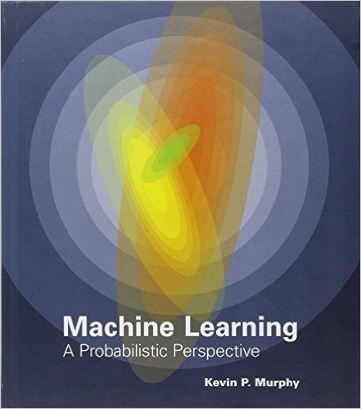
Book recommendation
Machine Learning: A Probabilistic Perspective (Adaptive Computation and Machine Learning Series)
by Kevin Murphy (Author)

Slide 12
AINT351: Machine Learning Ian Howard’s coursework tasks

Slide 13
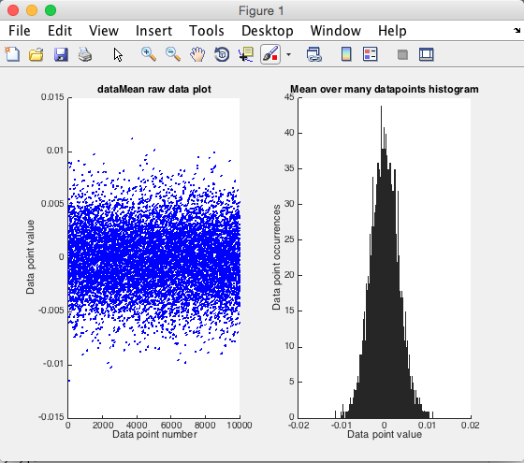
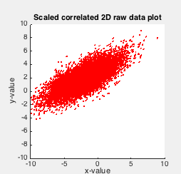
P1.1 Generate and plot 1 and 2D distributions
Generate probability distributions
Both 1 and 2 dimensional

Slide 14
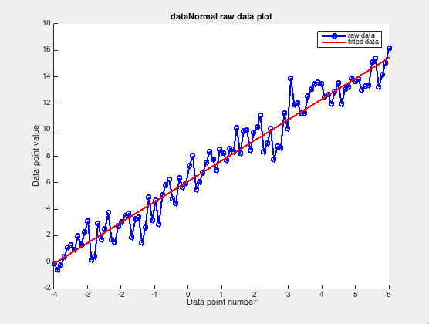
P1.2 Linear regression
Generate noisy line data
Implement linear regression
Fit the data with linear equations

Slide 15
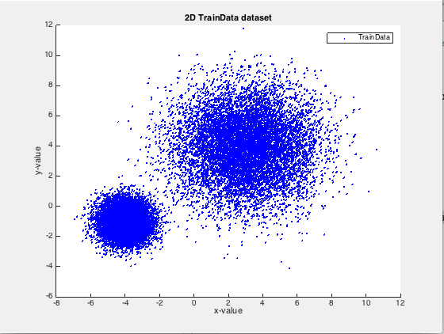
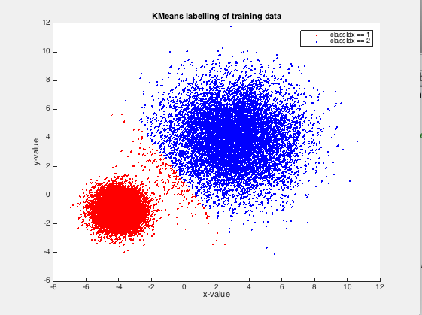
P1.3 KMeans clustering
Generate 2d dataset
Implement K-means
Label the data

Slide 16
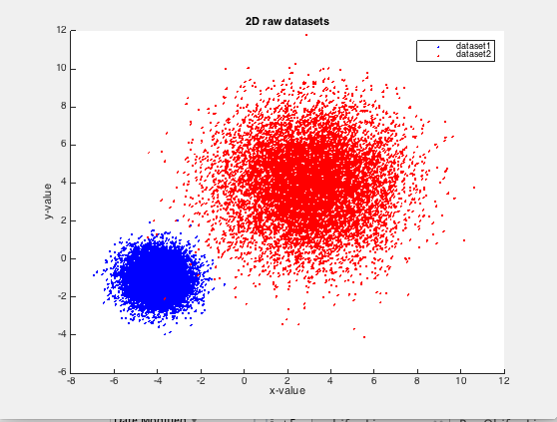
P1.4 Naïve Bayes and Perceptron Classifier
Generate 2d dataset
Implement supervised learning classifier
Classify the data

Slide 17
AINT351: Machine learning Three types of learning

Slide 18
Three types of learning
Imagine a machine experiences a sequence of sensory inputs
x₁, x₂, x₃, … x_{n}
Supervised learning: The machine is also given y₁, y₂, y₃, … y_{n}
and its goal is it to learn to reproduce then from the inputs
Unsupervised learning: The machine should build a representation of x that can be used for decision making, prediction, communicating etc.
Reinforcement learning: The machine can generate actions a₁, a₂, a₃, … a_{n} that affect its environment and receives a reward or punishment for them. Its goal is to learn actions that maximize long term reward

Slide 19
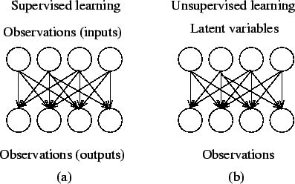
Supervised versus unsupervised

Slide 20
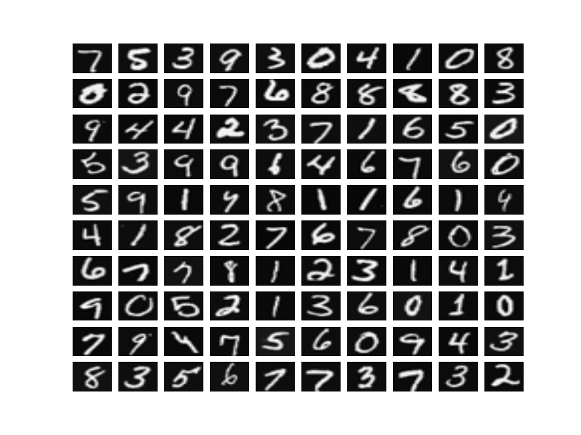
Goals of supervised learning
Classify input data
In this case the desired outputs y₁, y₂, y₃, … y_{n} are discrete class labels and the goal is to classify new output correctly from new input
E.g. character recognition
Have image of a digit and want to know classification
E.g. Robot recognizes an apple and then goes on to pick it

Slide 21
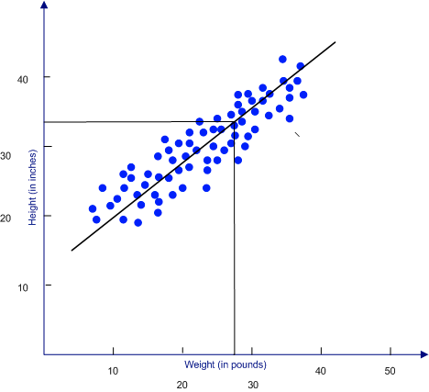
Goals of unsupervised learning
Regression
In this case the desired outputs y₁, y₂, y₃, … y_{n} are continuous values and the goal is to predict new output correctly from new input
E.g. Predict baby height given weight
Have data from babies, can fit line and then predict new baby height given their weight
E.g. Get time measurement from ultrasound sonar and convert to distance from obstacle

Slide 22
Goals of unsupervised learning
We wish to find useful representations of data. This can involve:
Finding clusters
Dimensionality reduction
Finding the hidden cause of the surface phenomena
Modeling the data probability density

Slide 23
Goals of unsupervised learning
Data compression – for communications
Outlier detection – to reject noise in measurements
Classification – recognize objects in environment
Latent representations form useful professing for other tasks – preprocessing for classifier
Understanding human learning and the brain – build intelligent robots!

Slide 24
AINT351: Machine learning Probability

Slide 25
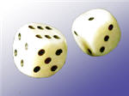
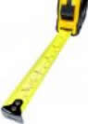
Types of data
Discrete data: only certain values (integers)
Dice value = {1,2,3,4,5,6}
Flip a coin = {H,T}
Continuous data: any value (real numbers)
Length measurement
Weight measurement
Blood pressure

Slide 26
Probability functions
A probability function maps possible values of a variable to its respective probabilities
E.g. if valuable is x we can write its possible probabilities as p(x)
Probability functions have the following properties
p(x) is a number with a value between 0 to 1.0.
The area under a probability function is always unity

Slide 27
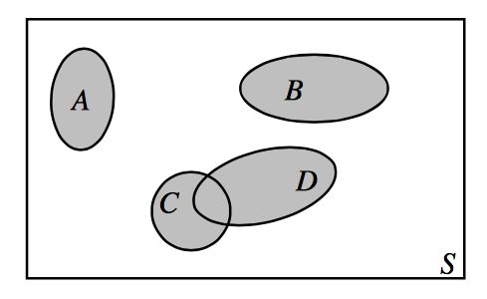
Venn diagrams can be used to represent relations between events
Venn diagrams

Slide 28
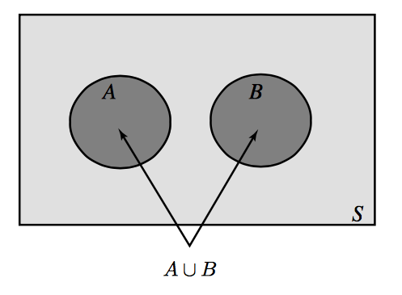
The Addition Law of Probability
If two events A and B are mutually exclusive then
P(A ∪ B) or the probability event A OR B occurs
P(A ∪ B) = P(A) + P(B)
Here P (A ∩ B) = 0

Slide 29
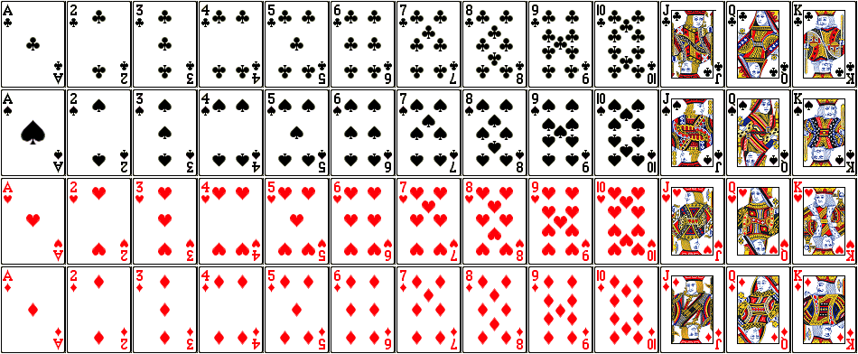
Illustrate with a pack of 52 cards

Slide 30
Probability of picking ace at random
Number of aces = 4
Number of cards = 52
P(card=ace) = 4/52

Slide 31
Probability of picking a two at random
Number of twos= 4
Number of cards = 52
P(card=two) = 4/52

Slide 32
Probability of picking {ace OR two}
Here there is no overlap so P(ace ∩ two) = 0
Therefore P(ace ∪ two) = P(ace) + P(two)
P(ace ∪ two) = (4+4)/52

Slide 33
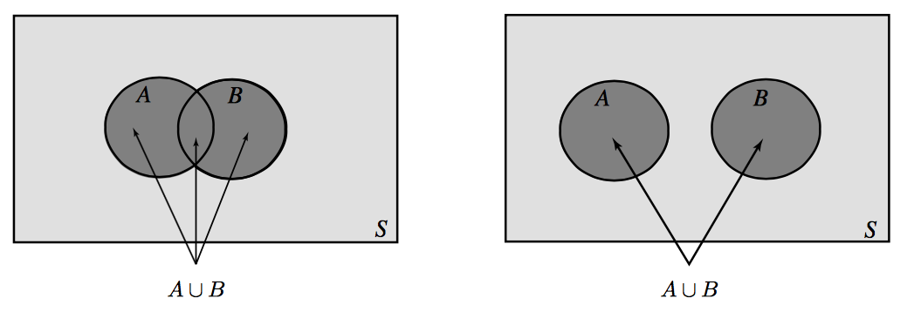
Venn diagrams to show event relations
A ∪ B denotes the event that A or B (or both) occur when the experiment is performed

Slide 34
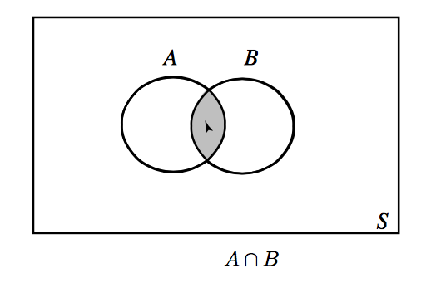
Venn diagrams to show event relations
A ∩ B denotes where both A and B overlap

Slide 35
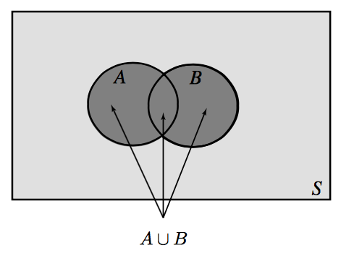
The Addition Law of Probability
General Case:
If two events are A and B and they intersect then
P (A ∪ B) = P (A) + P (B) − P (A ∩ B)

Slide 36
Probability of picking {ace U diamond}
Here P(ace ∩ diamond) = 1/52
P(ace ∪ diamond) = P(ace) + P (diamond) - P(ace ∩ diamond)
P(ace ∪ diamond) = (4+13-1)/52

Slide 37
Probability of picking ace of diamonds
Let A represent all 4 aces: p=4/52
Let B represent all 13 diamonds: p=13/52
(A ∩ B) is the 1 off ace of diamonds: p=1/52

Slide 38
AINT351: Machine learning Probability distributions

Slide 39
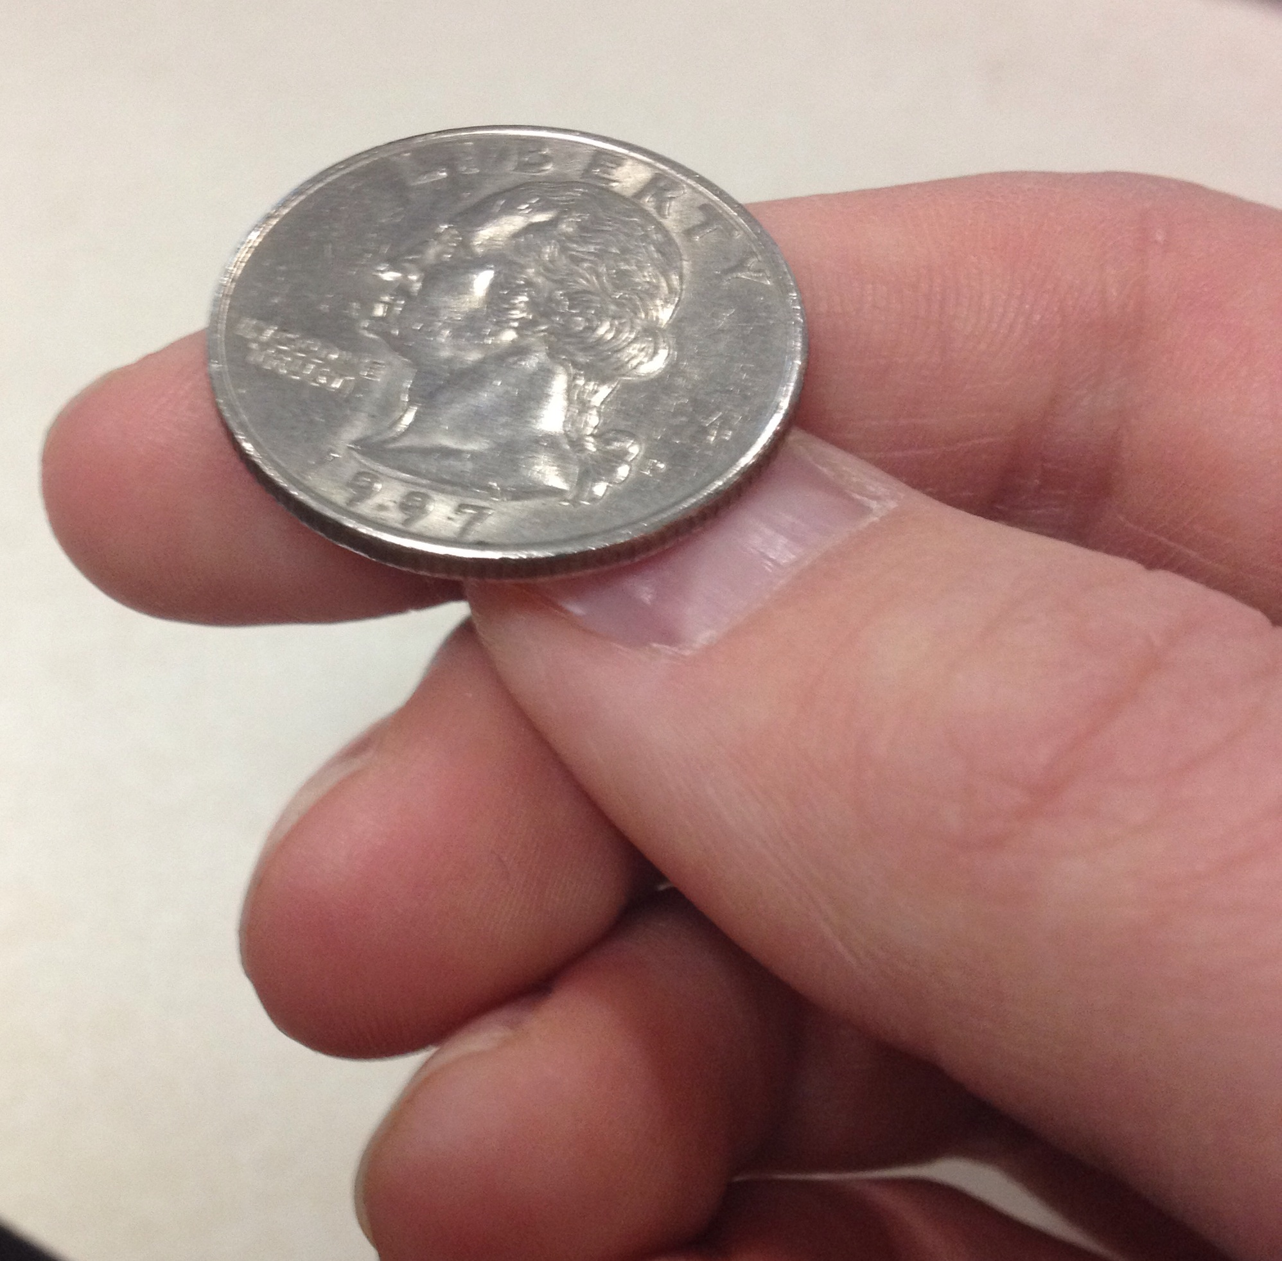
Discrete distribution
Heads or tails of a coin

Slide 40
Bernoulli distribution
This is the binomial distribution for n=1
Random variable which takes
Value 1 with success probability of p
Value 0 with failure probability of q = (1-p)
Heads or tails of coin flip
heads = p
tails = q

Slide 41
Discrete distribution
Throw a fair dice
1 of 6 outcomes
Each outcome has a probability = 1/6
p(x)
1/6
x
1
2
3
4
5
6
Probability over all outcomes sum to 1

Slide 42
Discrete distribution: e.g. dice outcomes
Probability of each outcome
Cumulative probability
x
p(x)
x
P(x≤A)
1
p(x=1)=1/6
1
P(x≤1)=1/6
2
p(x=2)=1/6
2
P(x≤2)=2/6
3
p(x=3)=1/6
3
P(x≤3)=3/6
4
p(x=4)=1/6
4
P(x≤4)=4/6
5
p(x=5)=1/6
5
P(x≤5)=5/6
6
p(x=6)=1/6
6
P(x≤6)=6/6
p(x)
1.0
P(x)
5/6
2/3
1/6
1/2
1/3
1
2
3
4
5
6
x
1/6
1
2
3
4
5
6
x
Distribution
Cumulative distribution

Slide 43
Binomial distribution
What’s the probability of getting exactly 3 heads in 5 coin tosses?
One case to get 3 heads is : HHHTT
Probability of this = P(heads)P(heads)P(heads)P(tails)P(tails)
If dice fair =(1/2)³ x (1/2)²
Another case to get 3 heads is : THHHT
Probability of this = P(tails)P(heads)P(heads)P(heads)P(tails)
If dice fair =(1/2)¹ x (1/2)³x (1/2)¹
Indeed there are several ways to get 3 heads in 5 coin tosses
But each have probability (1/2)³ x (1/2)²
Therefore overall probability of 3 heads and 2 tails is given by
N x (1/2)³ x (1/2)²
Where N is number of unique arrangements

Slide 44
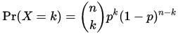
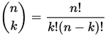
Binomial distribution
Outcome Probability
THHHT (1/2)³ x (1/2)²
HHHTT (1/2)³ x (1/2)²
TTHHH (1/2)³ x (1/2)²
HTTHH (1/2)³ x (1/2)²
HHTTH (1/2)³ x (1/2)²
HTHHT (1/2)³ x (1/2)²
THTHH (1/2)³ x (1/2)²
HTHTH (1/2)³ x (1/2)²
HHTHT (1/2)³ x (1/2)²
THHTH (1/2)³ x (1/2)²
There are N = 10 ways to get exactly 3 heads in 5 coin toss trials
Therefore overall probability of 3 heads and 2 tails is given by 10(1/2)³ x (1/2)² = 0.3125
The general formula for the probability of getting exactly k successes (here heads) in n trials is:
Where

Slide 45
Binomial distribution
Using the binomial formula
We can plot the probability of number of heads
tossed in 5 coin tosses
p(x)
p(x)
NB: binomial can be approximated as normal if np>5
x
0
1
2
3
4
5
number of heads

Slide 46
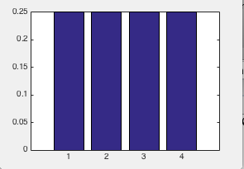
Probability distribution across colors
1
2
3
4
Discrete distribution - binomial
Each color had probability 13/52 = 0.25
Imagine if we had infinite distinctions
of card color…….

Slide 47
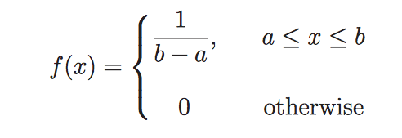
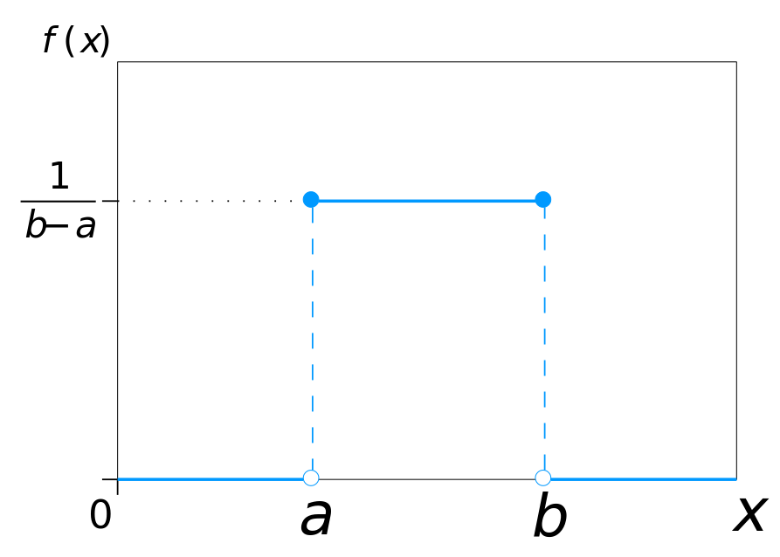
Uniform distribution
Random variable X is restricted to a finite interval [a,b] and f(x) has constant density often defined by a function of the form:
e.g. Position of hand on clock
But what is some values are
more common than others?

Slide 48
Uniform distribution
If we have a uniform distribution between 0 and 1, what is the probability that x falls between 0 and 0.5?
p(x)
p(0 <= x <=0.5) corresponds to area under distribution between 0 and 0.5
1
0
½
x
1

Slide 49
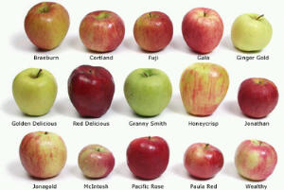
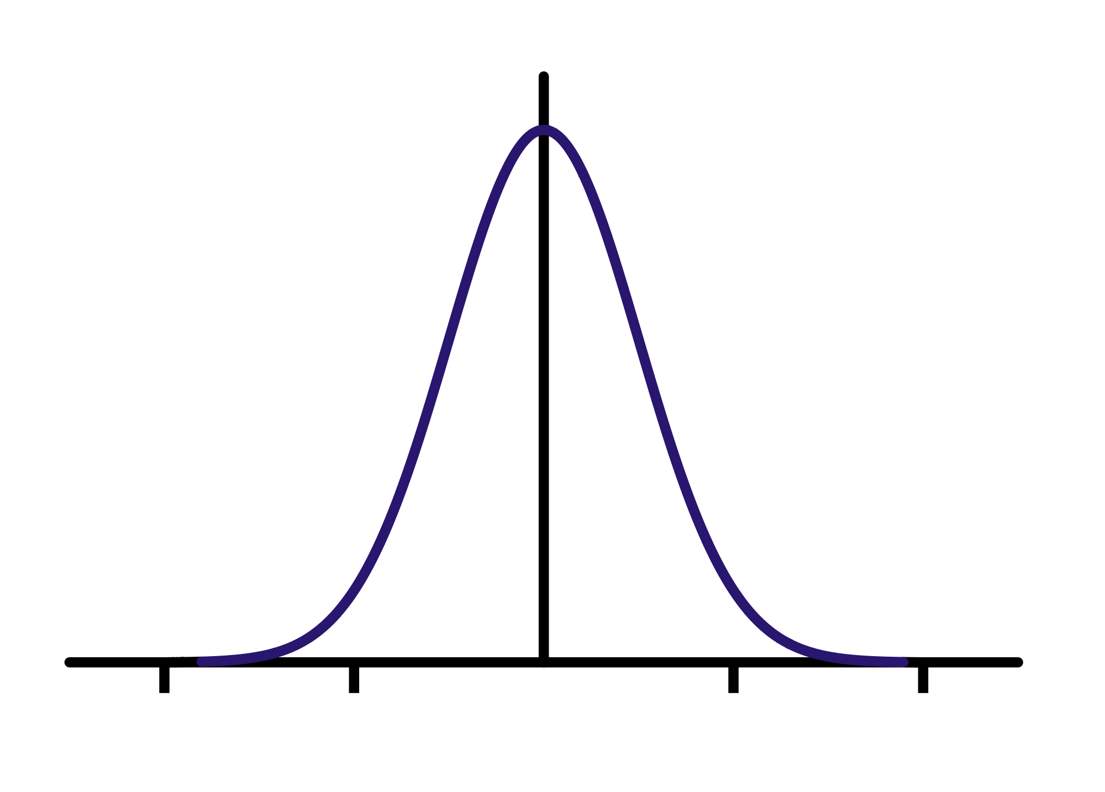
Continuous data distributions
If we measure the diameter of lots of apples, we will find they have a distribution of values
If we plot the sizes we might get a graph like this
Number of apples
diameter

Slide 50
AINT351: Machine learning Representing data

Slide 51
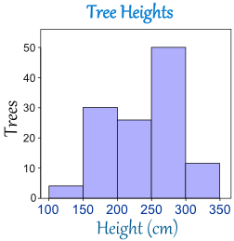
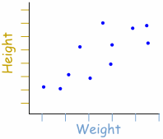
Displaying continuous values
Scatter plot
Histogram

Slide 52
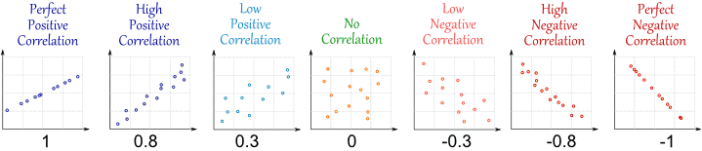
Independence and correlation
Consider a scatter plot for 2 variables
No correlation
No relationship at all
e.g. student height versus
air temperature

Slide 53
Independence and correlation
Consider a scatter plot for 2 variables
Low positive correlation
Some +ve relationship
Student height versus
future earnings

Slide 54
Independence and correlation
Consider a scatter plot for 2 variables
High positive correlation
Strong +ve relationship
Student weight versus
student height

Slide 55
Independence and correlation
Consider a scatter plot for 2 variables
Perfect positive correlation
Direct relationship
e.g. circle radius versus diameter

Slide 56
AINT351: Machine Learning Matlab examples

Slide 57
Sampling from a distribution
Matlab will give you samples from a distribution
Matlab uses algorithms to produce long sequences of pseudo-random numerical values
Matlab rand function
Return samples from a uniform distribution
Matlab randn function
Return samples from a normal distribution
Use help to find out more about use

Slide 58
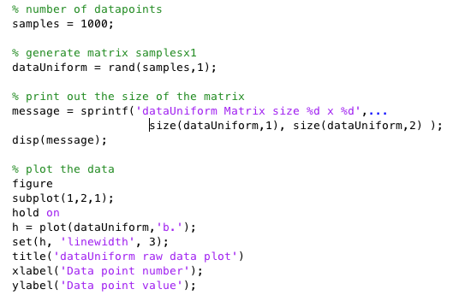
Matlab rand example

Slide 59
Useful Matlab commands
For plotting graphs - use Matlab help to find out more information
figure
plot
hist
hold on
Title
xlabel, ylabel
axis

Slide 60
Acknowledgements
Zoubin Ghahamani
web.stanford.edu/~kcobb

